Slide 1
ANDROID TRAINING DEMO
MEDIA PLAYER APP
14/02/2025

Slide 2
Introduction
Overview of the App
Objective : media player app that allows users to browse Songs , play, and manage their music library.
Key Features
Media Browsing
Playback Controls
Favourite Songs
Media Notification
Note : I’m using MVVM Architecture
<number>

Slide 3
Media Category Section
Description: Displays categories like Files, Artists, Albums, etc.
Implementation:
Layout with RecyclerView
Custom RecyclerView adapter with onClickListeners
<number>

Slide 4
Media Items Section
Description: Displays media items based on the selected category.
Implementation:
Layout with RecyclerView for media items
Custom adapter to bind media items to views
Logic to read and populate media items from metadata
Button for liking songs and adding to favorites

Slide 5
Currently Playing Media Section
Description: Shows album art and playback controls.
Implementation:
Layout with album art and buttons (Play/Pause, Next, Prev)
Methods to handle playback actions
UI updates for currently playing music data

Slide 6
MediaBrowserService
Purpose: To manage media browsing and playback.
Implementation:
onLoadChildren method to load media items
Implement Play , Pause , Prev ,Next and Notification also

Slide 7
Room Database for Favorites
Description: Stores favorite songs for easy access.
Implementation:
Setup database
Store all the data about the songs

Slide 8
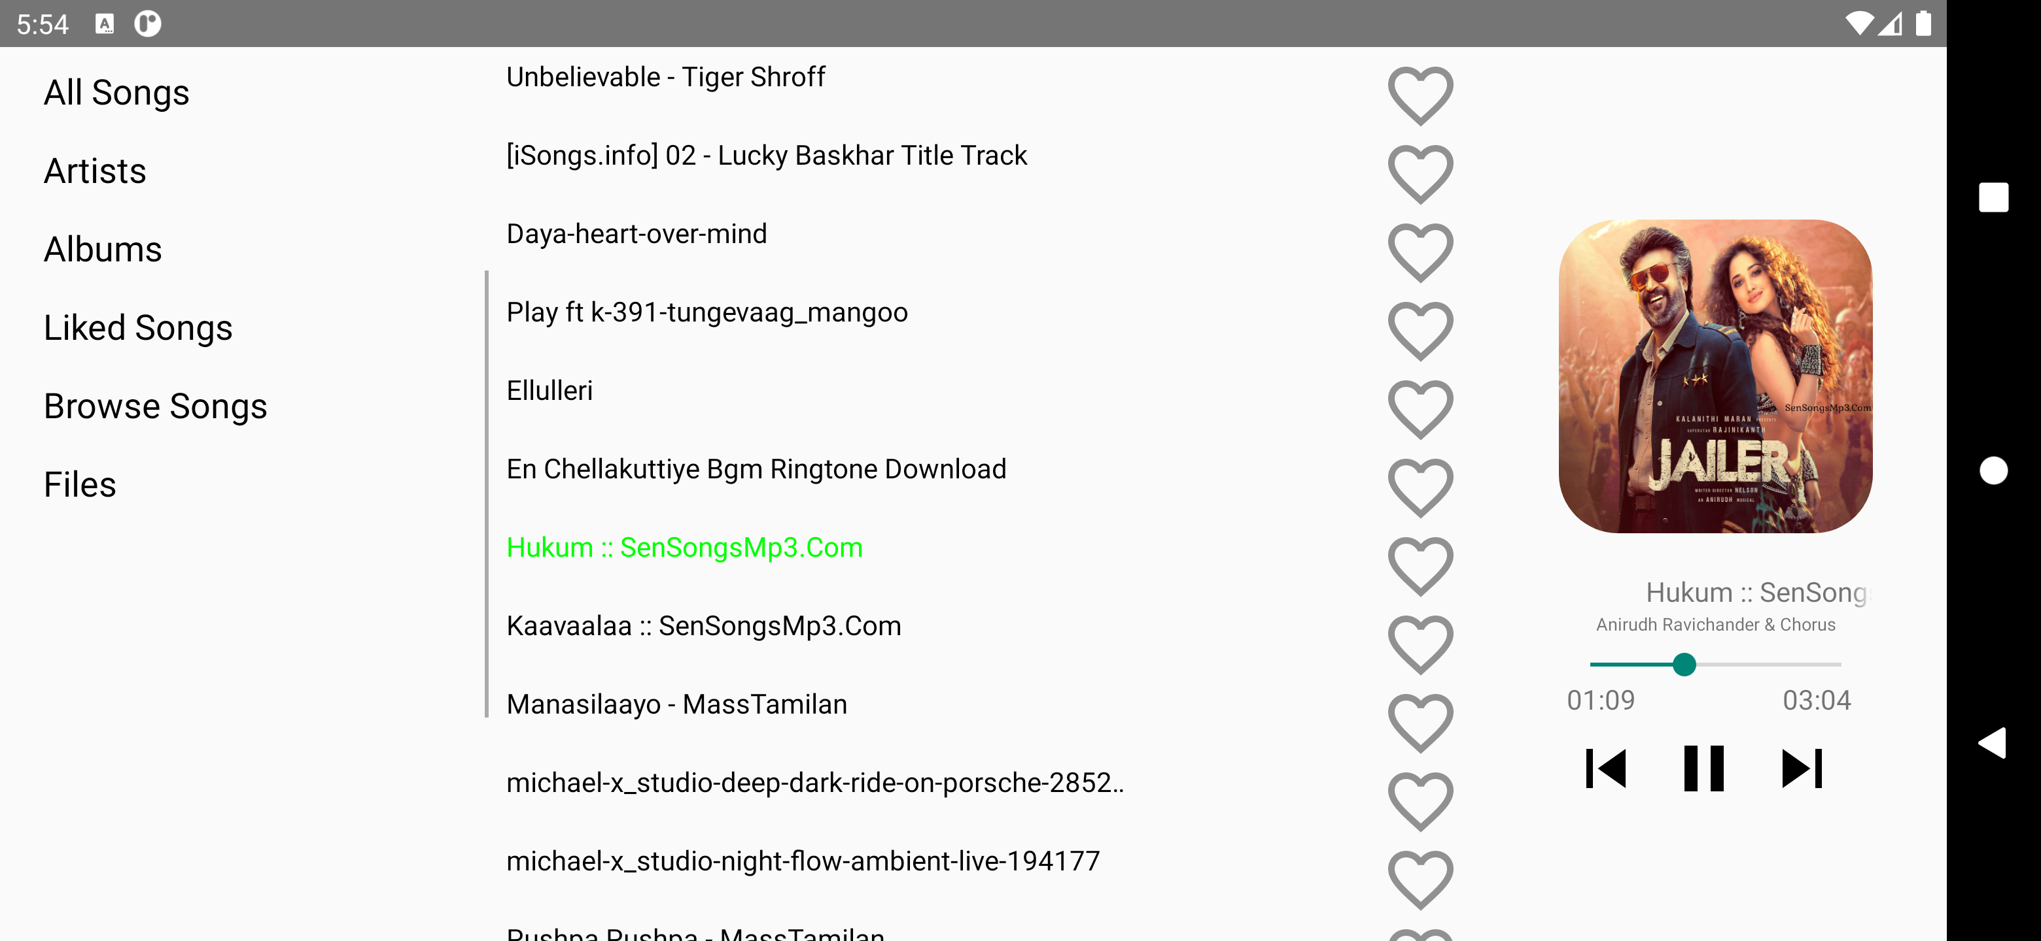
Media App ScreenShot

Slide 9
Pending Works
Waveform animation
File Browser
Time Duration
Selected Songs(now playing)
UI modification
Category Selection Bug
Bugs
Notification controns not showing android 13 and above
Category Selection
Music Player running during call

Slide 10
Thankyou

